Slide 1
Philosophical view on time
This is our big mistake: to think we look forward to death. Most of death is already gone. Whatever time has passed is owned by death.” – - Seneca
“People are frugal in guarding their personal property; but as soon as it comes to squandering time they are most wasteful of the one thing in which it is right to be stingy.” — Seneca

Slide 2


Slide 3
Time Management

Slide 4
Objectives
At the end of this lesson you will be able to
Understand the importance of time management and common time-related challenges.
Apply strategies to overcome them

Slide 5
Time
"Time" is the continuous progression of events from the past, through the present, and into the future. It’s often measured in units like seconds, minutes, hours, days, and years, giving structure to our experiences and activities. Time enables us to sequence events, understand duration, and manage our daily lives.
In physics, time is one of the fundamental dimensions of the universe, intertwined with space. Einstein’s theory of relativity suggests that time can vary based on speed and gravity, making it a more complex concept than just the ticking of a clock.
In our everyday lives, time is a practical tool for organizing and planning. It allows us to set goals, meet deadlines, and coordinate with others. Yet, on a philosophical level, time can feel mysterious—our awareness of it shapes our sense of urgency, memory, and change.

Slide 6
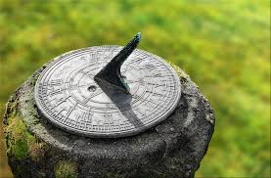
We measure time with clocks but they do not define it
Time is repetition
Early man used the sun dial to measure time based on the repetion of the earths movements
1656 the 1st pendulum clock . Now atomic clocks that measure time based on the repetition of the caesium atom
Chronometry or horology ( lit. 'the study of time') is the science studying the measurement of time and timekeeping.

Slide 7
The human brain is equipped to track time. The suprachiasmatic nuclei of the brain is the region responsible for daily or circadian rhythms. But neurotransmitters and drugs affect time perceptions.
Time seems to slow down during emergencies or danger. Scientists at Baylor College of Medicine in Houston say the brain doesn't actually speed up, but the amygdala becomes more active. The amygdala is the region of the brain that makes memories. As more memories form, time seems drawn out.
The same phenomenon explains why older people seem to perceive time as moving faster than when they were younger. Psychologists believe the brain forms more memories of new experiences than that of familiar ones. Since fewer new memories are built later in life, time seems to pass more quickly.

Slide 8
QUIZ
How often do you feel like you don’t have enough time to complete your tasks?
Rarely B. Sometimes C. Often D. Almost Always
Do you make to-do lists or use a planner regularly?
A. Always B. Sometimes C. Rarely D. Never
How often do you find yourself getting distracted while working?
A. Rarely B. Sometimes C. Often D. Almost Always
How frequently do you complete tasks right before the deadline?
A. Rarely B. Sometimes C. Often D. Almost Always
When you have a task to complete, do you usually start immediately or delay it?
A. Start Immediately B. Start After Some Delay C. Delay Until Necessary D. Delay Until Last Minute

Slide 9
Quiz Scoring:
Mostly A’s: You have good time management habits.
Mostly B’s: You have fair time management but could benefit from structure.
Mostly C’s and D’s: Time management is a challenge; structured approaches can help improve.

Slide 10
Group Discussion
What are the biggest obstacles you face when managing your time, especially in a teaching or learning environment?
How do personal responsibilities or distractions (like phone use) affect your productivity?
Discuss a time when you felt overwhelmed with tasks. What factors contributed to that feeling?
How does procrastination impact your daily life? What are some common reasons for procrastinating?
What techniques, if any, have you tried to improve your time management? Were they effective?

Slide 11
What is time management
Time management is the ability to use your time effectively by organizing and planning how to divide your time between specific activities

Slide 12
Time Management Challenges
Procrastination and lack of prioritization.
Interruptions and distractions, such as social media or personal responsibilities.
Overcommitting and struggling to say “no” to extra tasks.
Not setting clear goals or action plans, leading to disorganization. Ineffective planning tools or reliance on memory instead of written schedules.

Slide 13
Importance of time management (for teachers )
More time for teaching.
By carefully planning your time, you will waste less of it on things like looking for lost materials or dealing with disruptions. Instead, you will ensure that you have more time for the thing that matters most – teaching.
Optimal work-life balance.
Good time management skills help to strike a better balance between your work and personal life. Proper planning and control will reduce your stress levels to a large degree. As a consequence, you’ll notice a significant improvement in your overall well-being.
Better student outcomes.
When teachers manage their time effectively, it can lead to improved student outcomes as well. This is because you get more time available for things like lesson planning and preparation, which can result in more engaging and effective lessons.
Greater job satisfaction.
Time management empowers you to accomplish more and make a real difference in your students’ lives. And when you feel like you’re in control of your time and everything is more organized, you begin to enjoy the process more, and your job satisfaction naturally increases.
Higher productivity.
Thanks to time management, your concentration and well-being can get much better than in the lack of good organization. And when you’re energized, able to focus on one task and give it your full attention, you’ll be amazed at how much more quickly and easily the work gets done
.

Slide 14
Prioritization
Have you ever felt overwhelmed by tasks piling up? What caused it?
What’s an example of a time you prioritized the wrong task? How did it affect your day?
What strategies have helped you stay ahead of your workload?

Slide 15
Cost of Poor Prioritization
Increased Stress and Burnout: Constantly chasing deadlines leads to anxiety and exhaustion.
Missed Deadlines: Key tasks (e.g., submitting grades) may be delayed
Reduced Productivity: Time is wasted on low-priority activities, leaving critical work unfinished.
Negative Impact on Students: Poorly prepared lessons or late feedback disrupts student learning and progress.
Strained Relationships: Missed commitments or delays in team projects create tension with colleagues.
Loss of Opportunities: Inability to focus on long-term goals, like professional development or certifications.

Slide 16
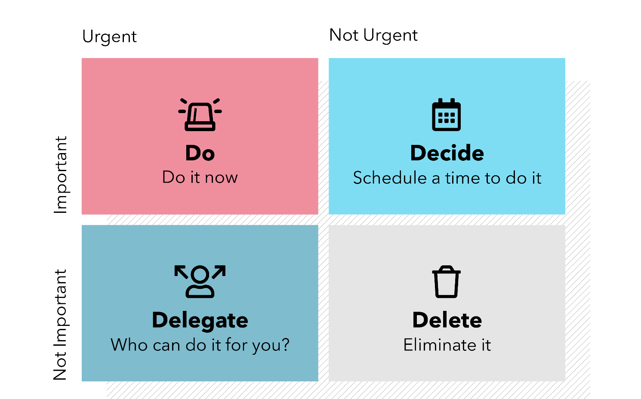
Eisenhower Matrix
Named after Dwight D. Eisenhower, a former U.S. president. Focuses on urgency and importance as the primary criteria for decision-making.
Goal: Distinguish between tasks that require immediate attention versus those that can be delegated or eliminated.

Slide 17
Urgent & Important:
Tasks that require immediate attention.
Not Urgent & Important:
Tasks that contribute to long-term goals or effectiveness but can be scheduled.
Urgent & Not Important:
Tasks that should be delegated if possible.
Not Urgent & Not Important:
Tasks that are time-wasters and should be avoided

Slide 18
Sort into the fours quadrants
Grade students’ assignments due tomorrow.
Reply to your superiors email
Prepare lesson plans for next week.
Clean up the files on your computer
Help a colleague with a request
Read a novel from your favourite author
Read a essay for your portfolio
Arrange desks in the classroom before the next session.
Respond to a text message from a friend about weekend plans.
Check social media for ideas on classroom decorations.
Watch the latest movie on Netflix.
Print hand-outs for tomorrow’s lesson.
Review the syllabus to prepare for an annual curriculum review meeting scheduled for next month.
Plan a birthday surprise for a colleague during lunch.

Slide 19
Step 1 : Set two goals in each area
Academic: Complete the first draft of my assignment by Friday.
Personal: Exercise for 30 minutes, 5 days a week, for the next month
Step 2: Identify the tasks
For each goal:
Write down tasks or steps required to accomplish it.
Be specific (e.g., "Read three journal articles for my assignment" instead of "Study").

Slide 20
Step 3 : Prioritize Tasks Using the Eisenhower Matrix
Step 4 : Create a weekly plan
Allocate specific days and times for each task.
Use a table, planner, or digital calendar to organize tasks.

Slide 21
PROCRASINATION

Slide 22
What it is?
The act of delaying or postponing tasks or decisions, often unnecessarily, despite knowing that doing so might have negative consequences.
Example: Have you ever delayed starting an assignment until the night before, even though you had weeks to work on it?

Slide 23
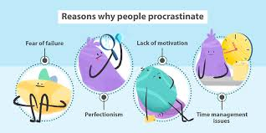

Slide 24
Why?
Fear of Failure
Avoiding a presentation because you’re anxious about speaking in front of others.
Lack of Interest or Motivation
Procrastinating on cleaning your room because it feels boring or unimportant.
Perfectionism
Spending hours tweaking an essay introduction instead of writing the whole draft.
Feeling Overwhelmed
Putting off studying for a big exam because the material feels unmanageable.
Poor Time Management or Prioritization
Sometimes procrastination happens simply because people don’t allocate time effectively or struggle to prioritize tasks.

Slide 25
Results
Procrastination often leads to rushed work or missed deadlines, resulting in subpar performance.
Important tasks may pile up, creating unnecessary stress and making it harder to focus.
Procrastination creates a cycle of stress, as tasks left undone loom over you.
Chronic procrastinators often feel guilty or frustrated with themselves, which can harm self-esteem.
Constantly playing catch-up leads to exhaustion and burnout, especially when deadlines are tight.
Delaying tasks can mean missing out on valuable opportunities, whether in education, career, or personal growth.

Slide 26
How to cope
Time blocking
Chunking
80/20 Rule
The Pomodoro technique
Setting Deadlines ( scheduling)
Use the Eisenhower matrix to prioritise
Eliminate Distractions and setting boundaries

Slide 27

What is the Pomodoro Technique

Slide 28
What is the 80/20 Rule

Slide 29

What is Time Blocking

Slide 30

What is Chunking

Slide 31
What is Scheduling

Slide 32
How to eliminate distractions and set boundaries.

